Slide 1

Password Hardening using ML based algorithms
Nividh Singh

Slide 2
Cybersecurity
Cybersecurity is the practice of deploying people, policies, processes and technologies to protect organizations, their critical systems and sensitive information from digital attacks
The goal of cybersecurity is to prevent malicous users from gaining access to systems or information

Slide 3
Cybersecurity – Data Transfer
Two main algorithms: AES and RSA
RSA
  Use public and private keys
  Really secure because they use large prime numbers
  Hard to get private keys because there’s no algorithms or large enough computing power to factor the numbers
AES
  Symetric Keys
  Block Encrpytion

Slide 4
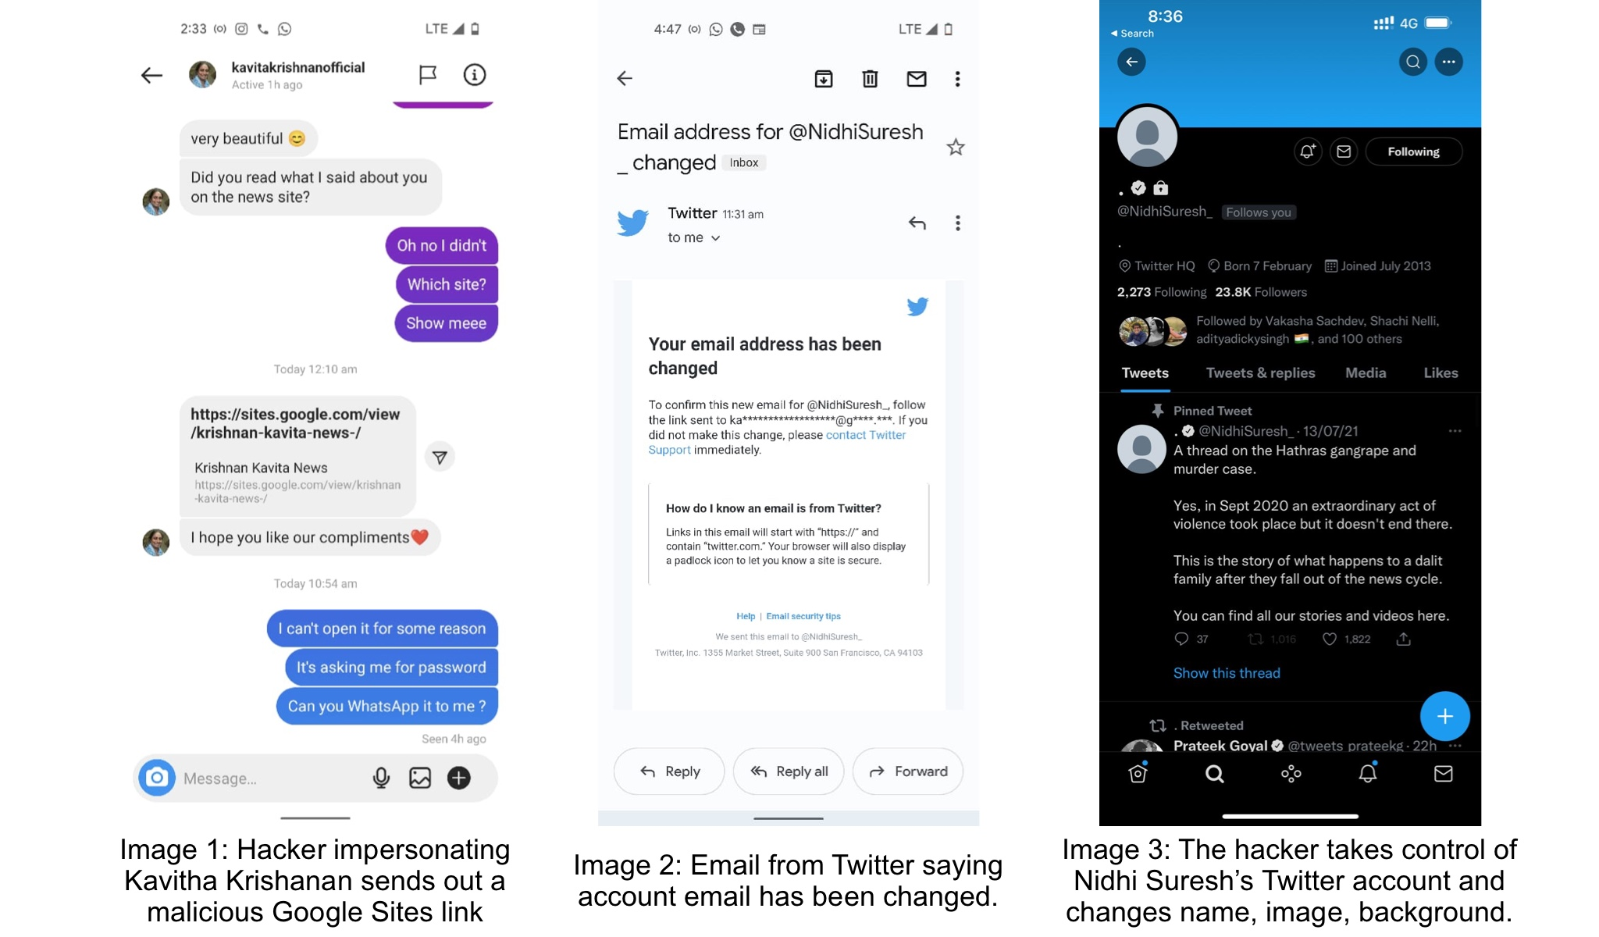
Social Engineering
Social engineering is the term used for a broad range of malicious activities accomplished through human interactions.

Slide 5
Password Hacking
In cryptanalysis and computer security, password cracking is the process of recovering passwords from data that has been stored in or transmitted by a computer system in scrambled form.
  Some how hack into the system and find the password
  Use brute force to “guess“ the password

Slide 6
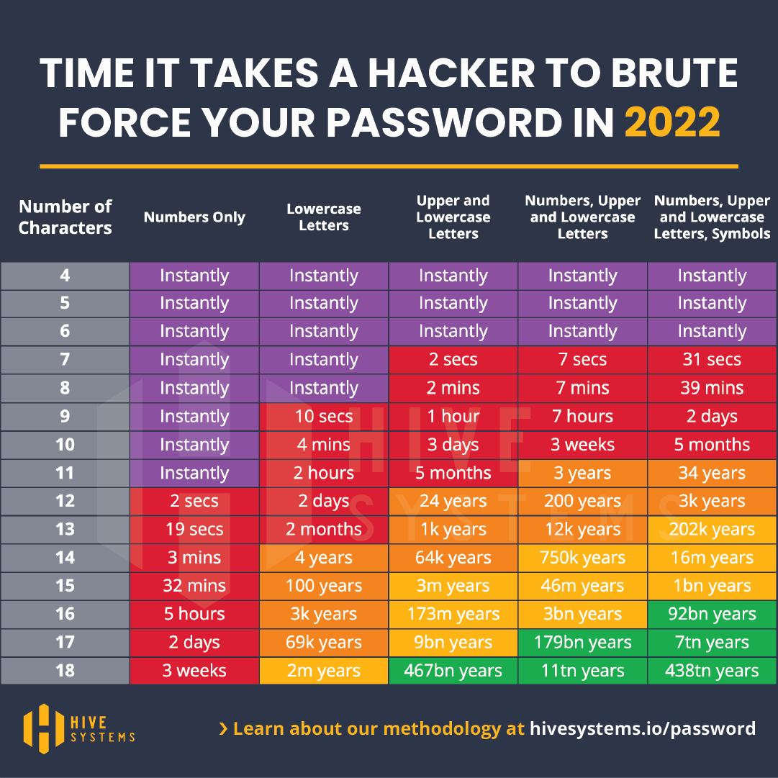
Password Hacking

Slide 7
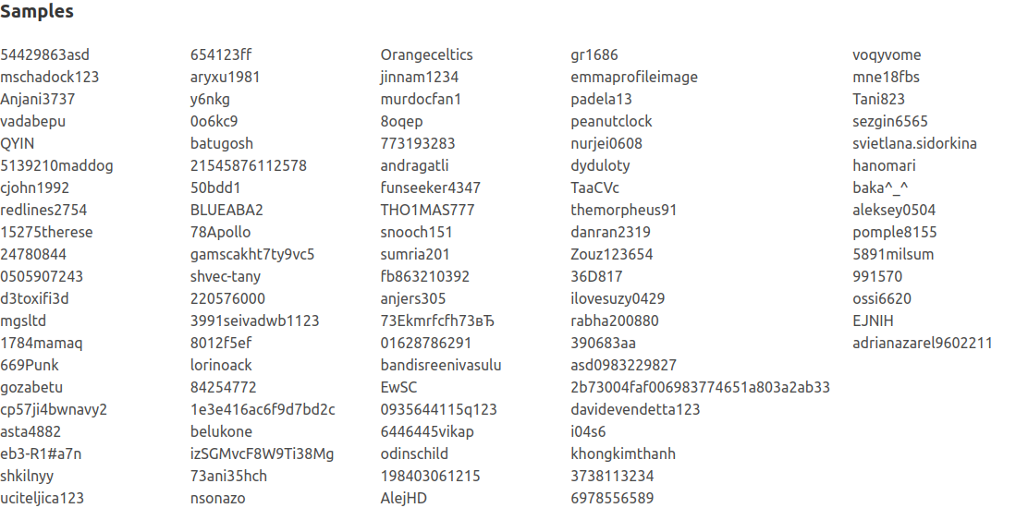
Password Hacking

Slide 8
Ethical Hacking
Hacking to prevent the effect of malicious attacks
Prepare systems to be robust against attacks

Slide 9
Algorithms

Slide 10
Alphabetical Order
Tests the passwords in alphabetical order
Algoirthms can have different “alphabetical orders“
  Some might put numbers before letters
  Some might put uppercase seperate from lowercase
Good Passwords | Bad Passwords
2b73004faf006983774651a803a2ab33 | andragatli
73ani35hch | eb3-R1#a7n
svietlana.sidorkina | Anjani3737

Slide 11
Probabilistic Order
Takes in all the passwords that have been linked
Breaks the passwords down into subsets of charectors
Uses machine learning to try to predict the next charector from the previous charectors
1 → 2 → 3 → 4 → 5 12345
1 → 2 → 3 → 4 → 6 12346

Slide 12
English Words
This algorithm takes a library of english words and puts charectors between them
(charectors(s)) + word + (charectors(s)) + word + (charectors(s)) = password
eg. 78 + Apollo = 78Apollo
Good Passwords | Bad Passwords
2b73004faf006983774651a803a2ab33 | emmaprofileimage
21545876112578 | ilovesuzy0429
gamscakht7ty9vc5 | 78Apollo

Slide 13
Results & Conclusion
The more methods that were used, the more passwords were labeled as not secure
There were a lot of passwords in the databases that weren’t good passwords
Using this type of model would work better instead of the 12 charector, 1 number, 1 special charector, 1 uppercase and 1 lowercase letter approach

Slide 14
Future Steps
Implement more methods for hacking, so more weak passwords can be taken out
  Only use numbers (nnnnnn)
  Only use letters (llllll)
  Keep numbers grouped and letters grouped (nnnlll)
Implement a custom training loop for better performance

Slide 15
Questions?

